Slide 1
ANFIS ‒ Adaptive Network-Based Fuzzy Inference System

Slide 2
What is ANFIS?
There is a class of adaptive networks that are functionally equivalent to fuzzy inference systems.
• The architecture of these networks is referred to as ANFIS, which stands for adaptive network - based fuzzy inference system or semantically equivalently, adaptive neuro -fuzzy inference fuzzy inference system.

Slide 3
Applications
Thermal error compensation on CNC machine tools.
Brain Tumour Detection
Mobile Learning
Clinical Decision Support System
Food Processing and Technology
Modeling for tensile strength of friction welded aluminium pipes

Slide 4
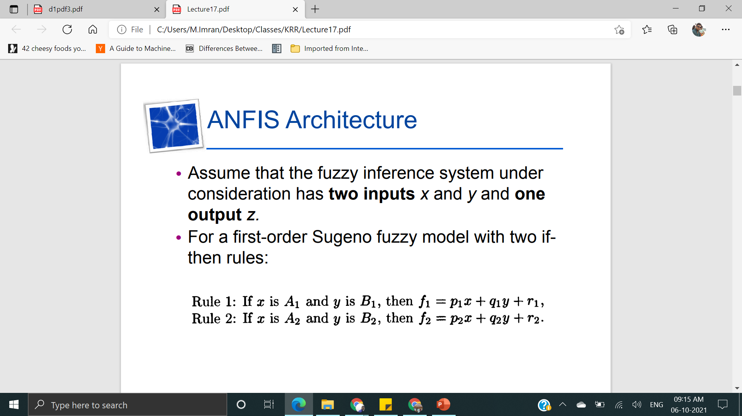
Architecture

Slide 5
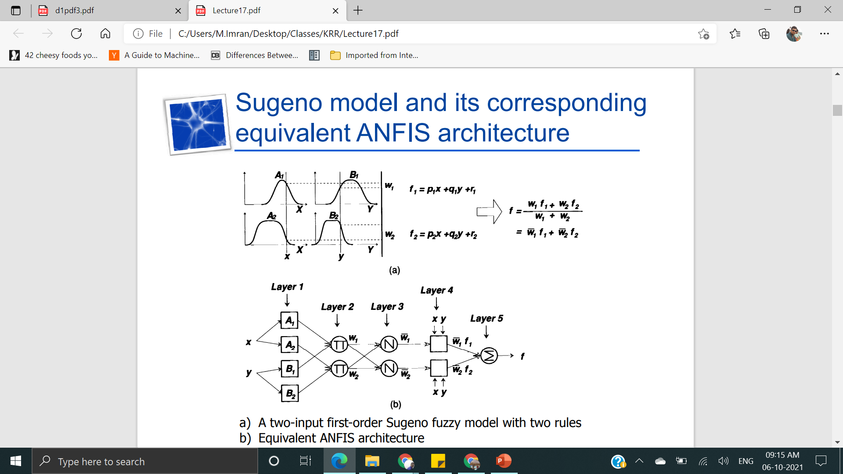

Slide 6
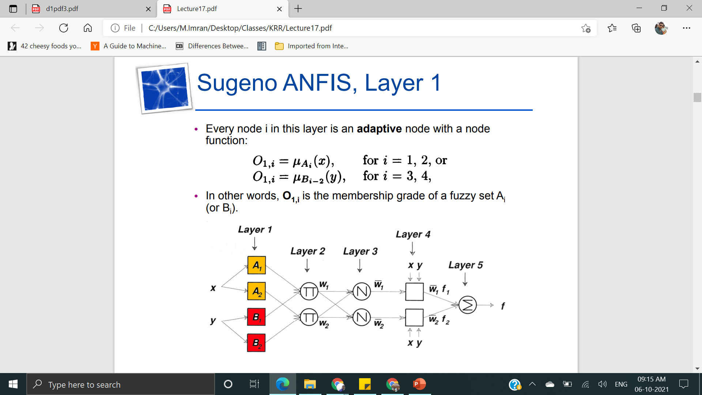
Layer 1

Slide 7
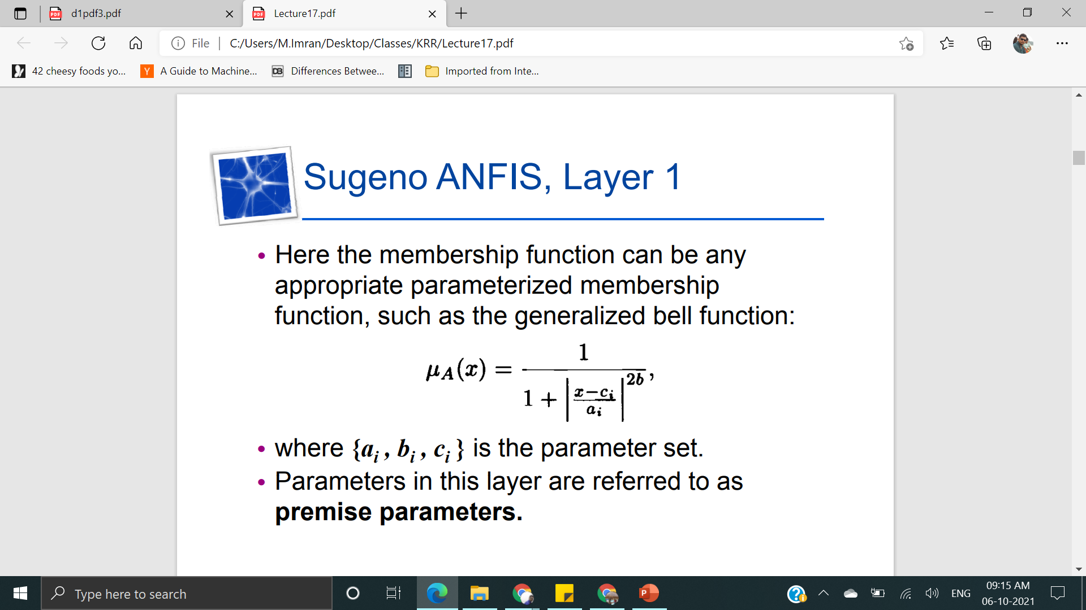

Slide 8
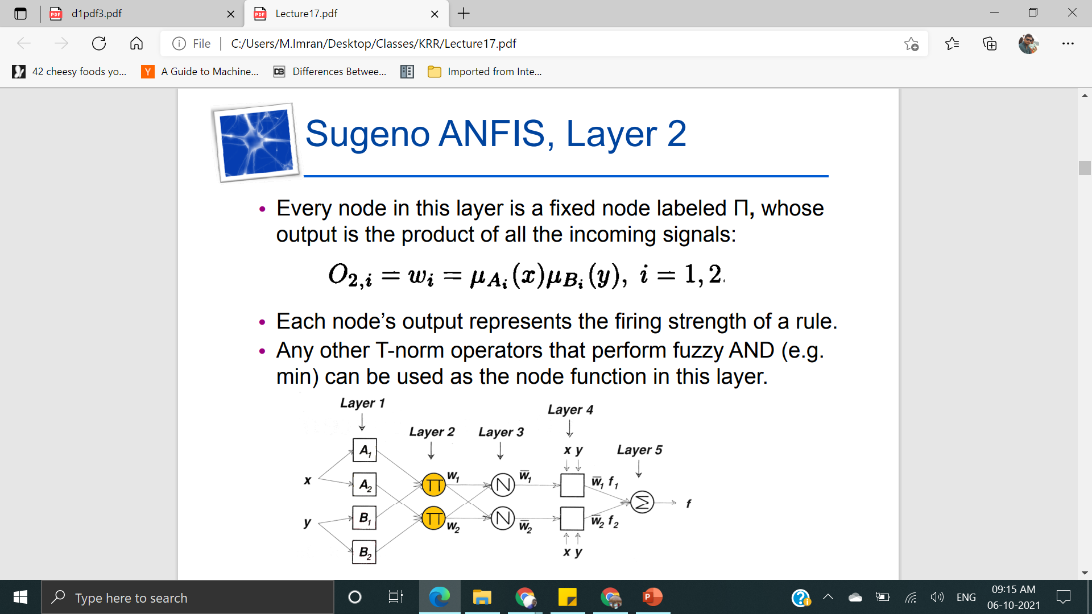
Layer 2

Slide 9
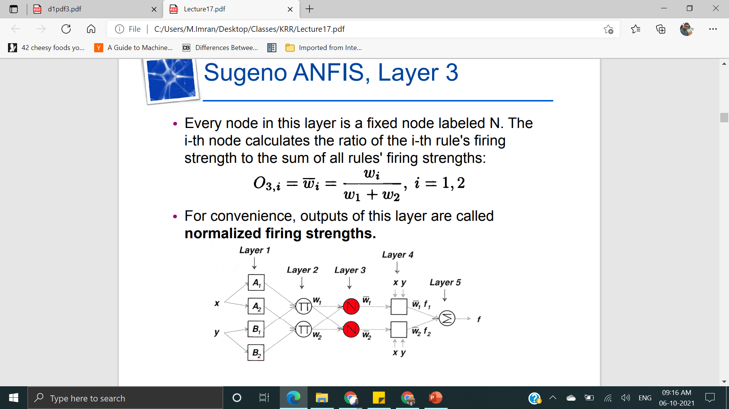
Layer 3

Slide 10
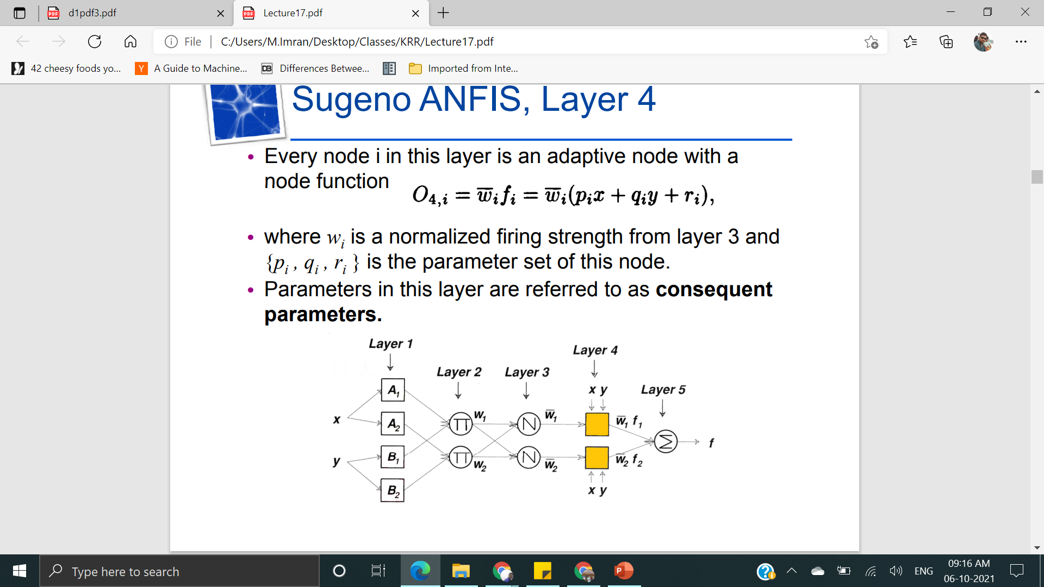
Layer 4

Slide 11
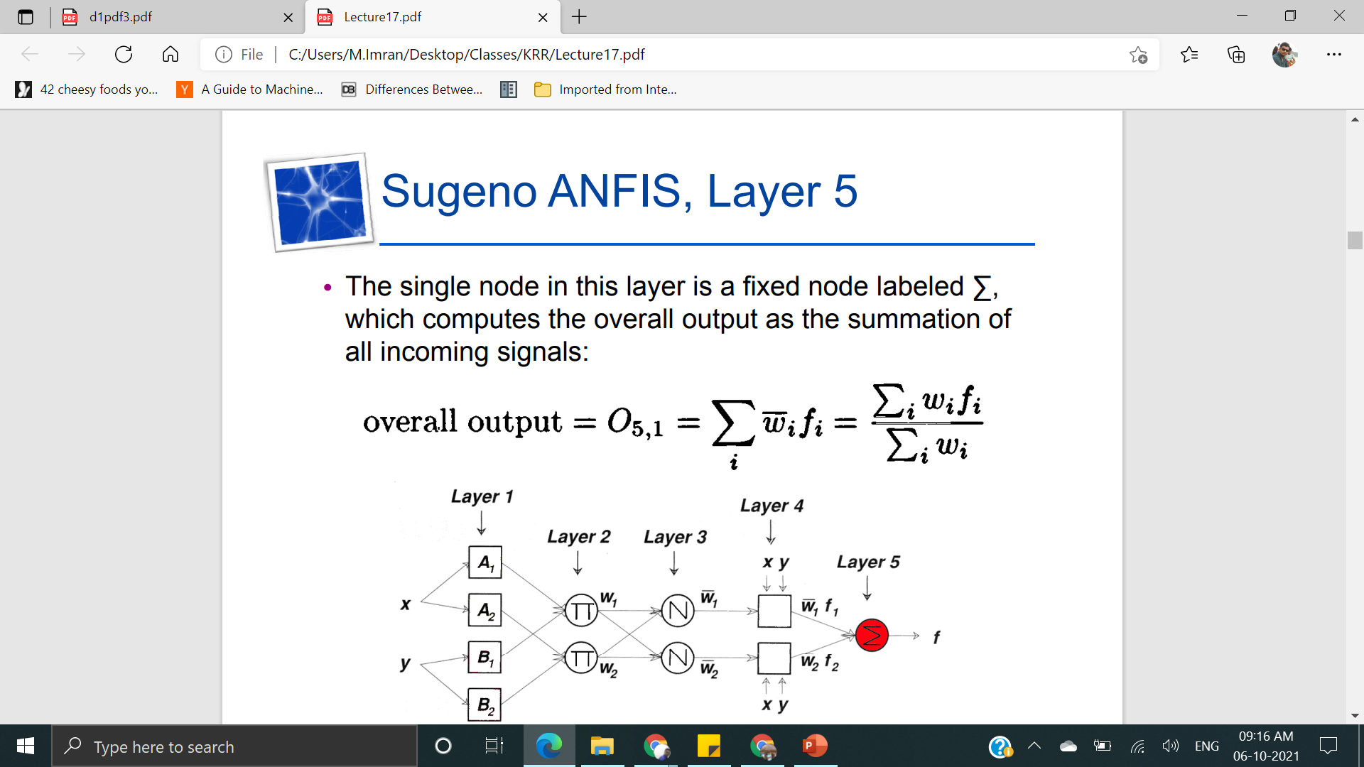
Layer 5

Slide 12
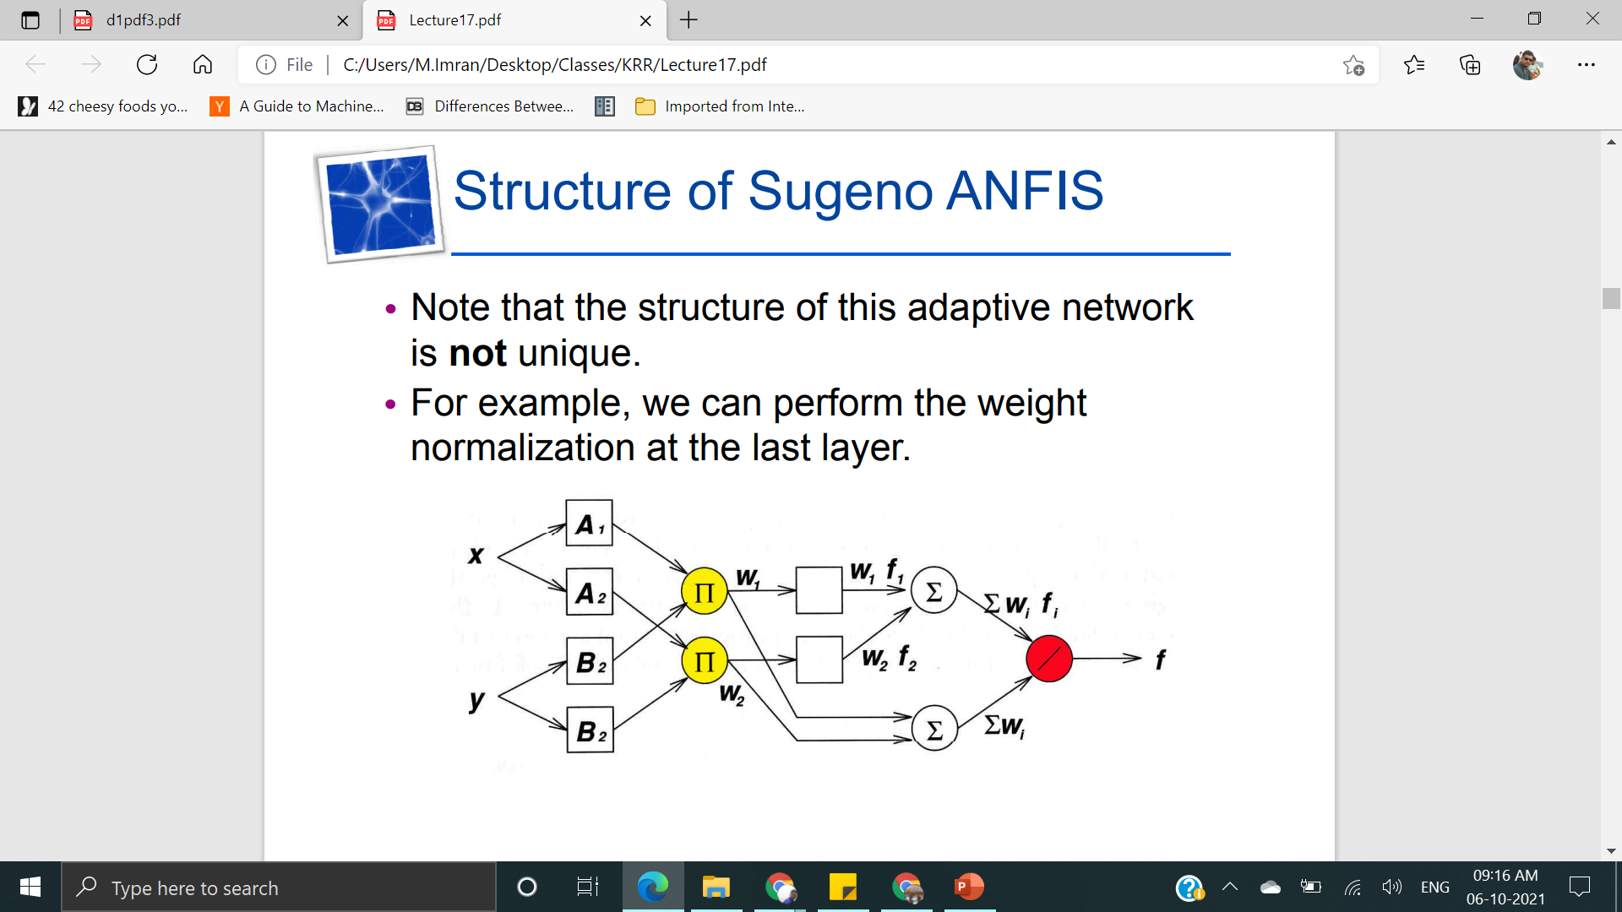
Structure of Sugeno ANFIS

Slide 13
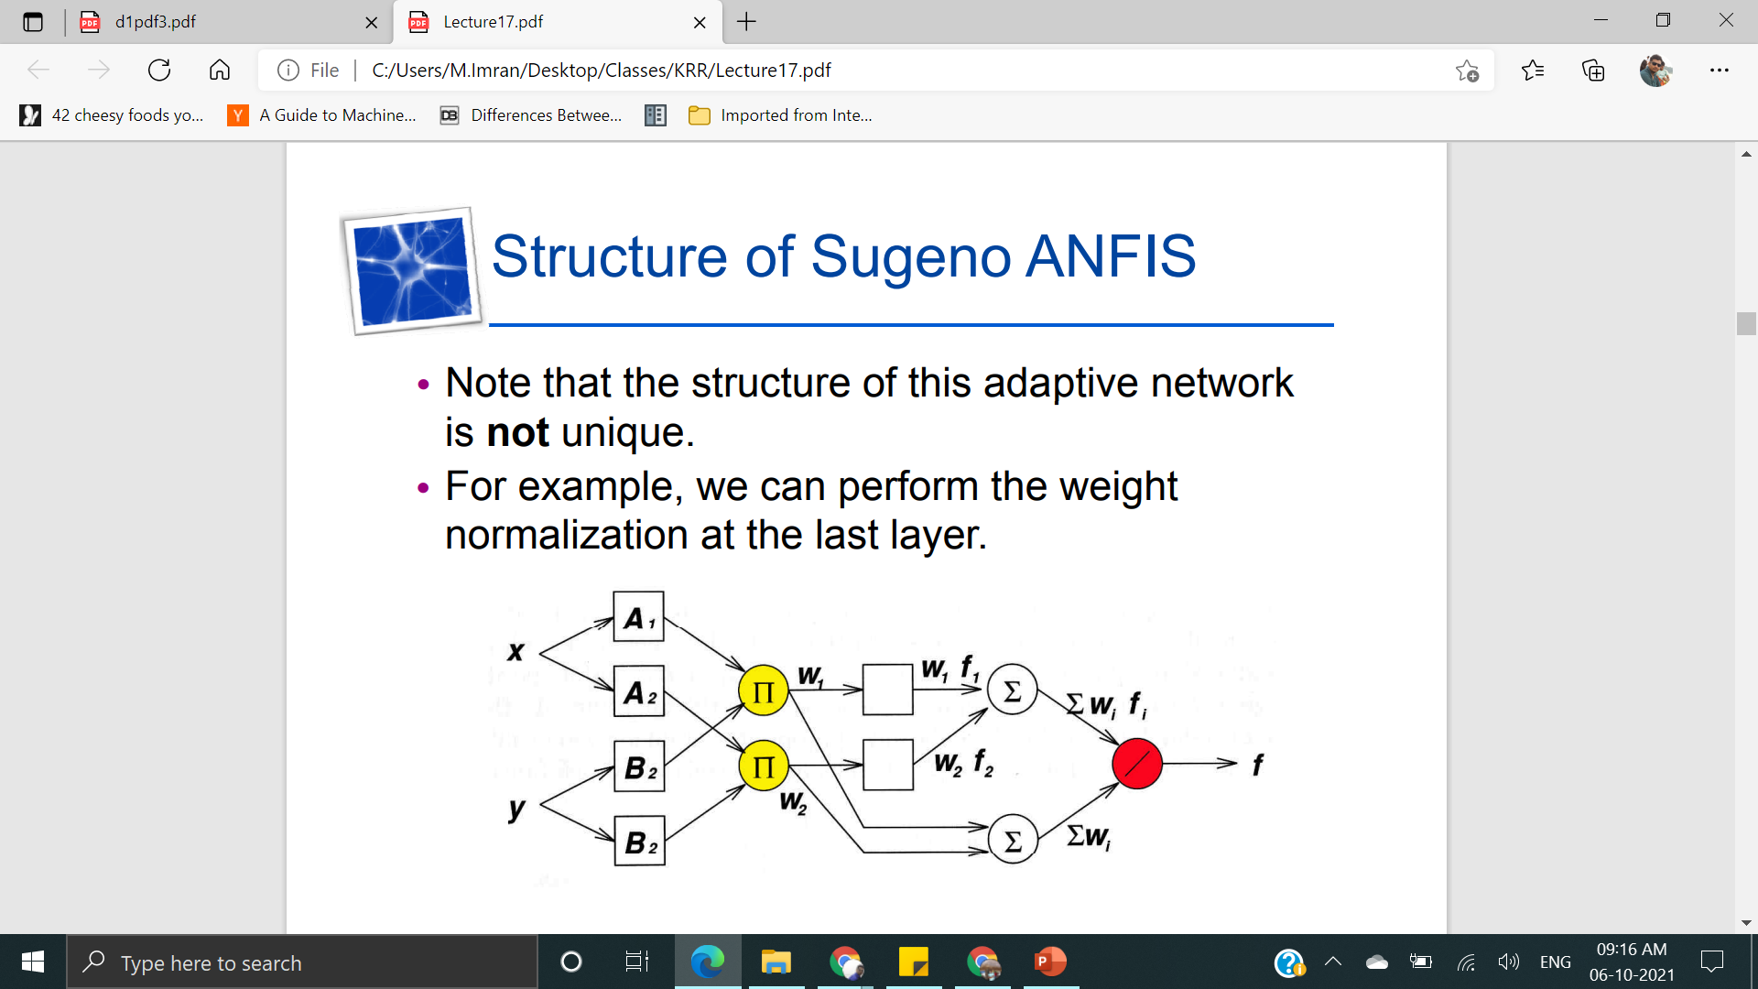
Contd..

Slide 14
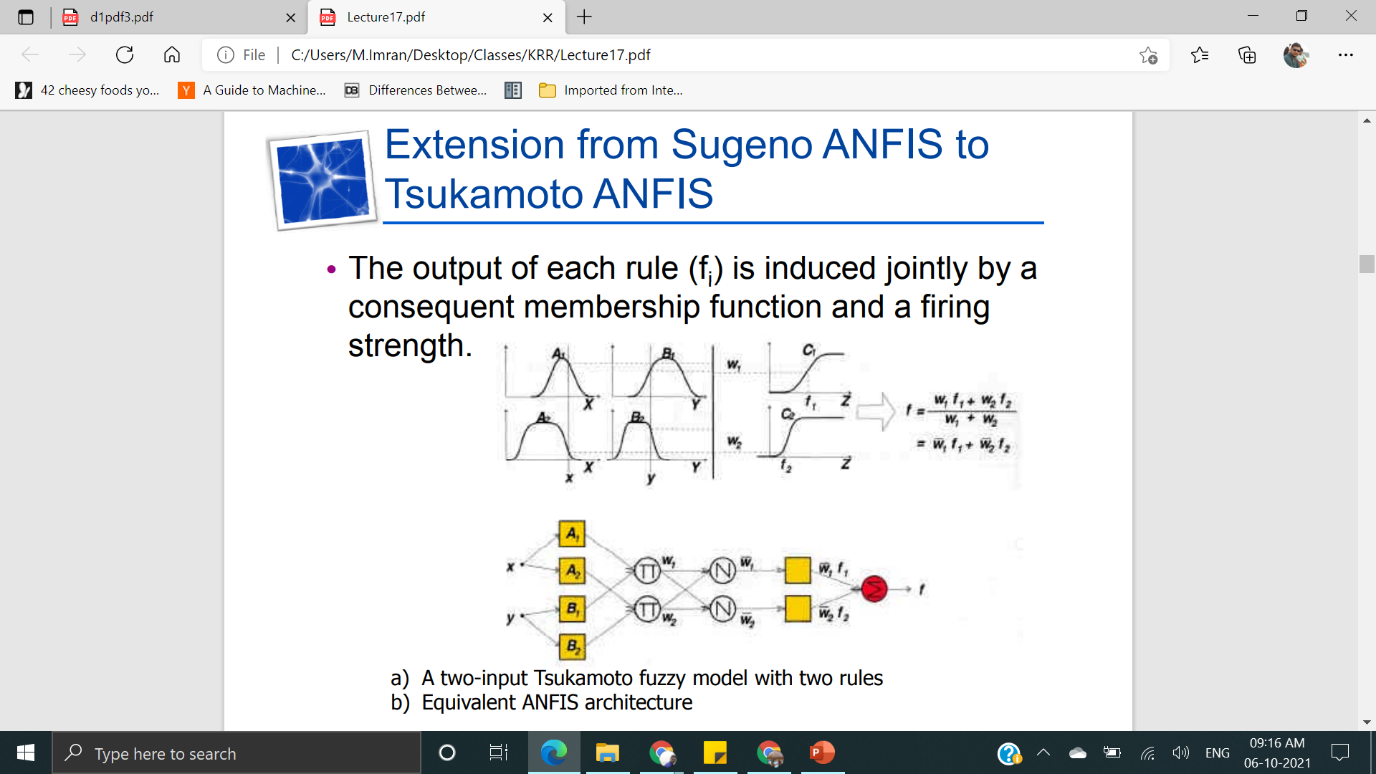
Extension from Sugeno ANFIS to Tsukamota ANFIS

Slide 15
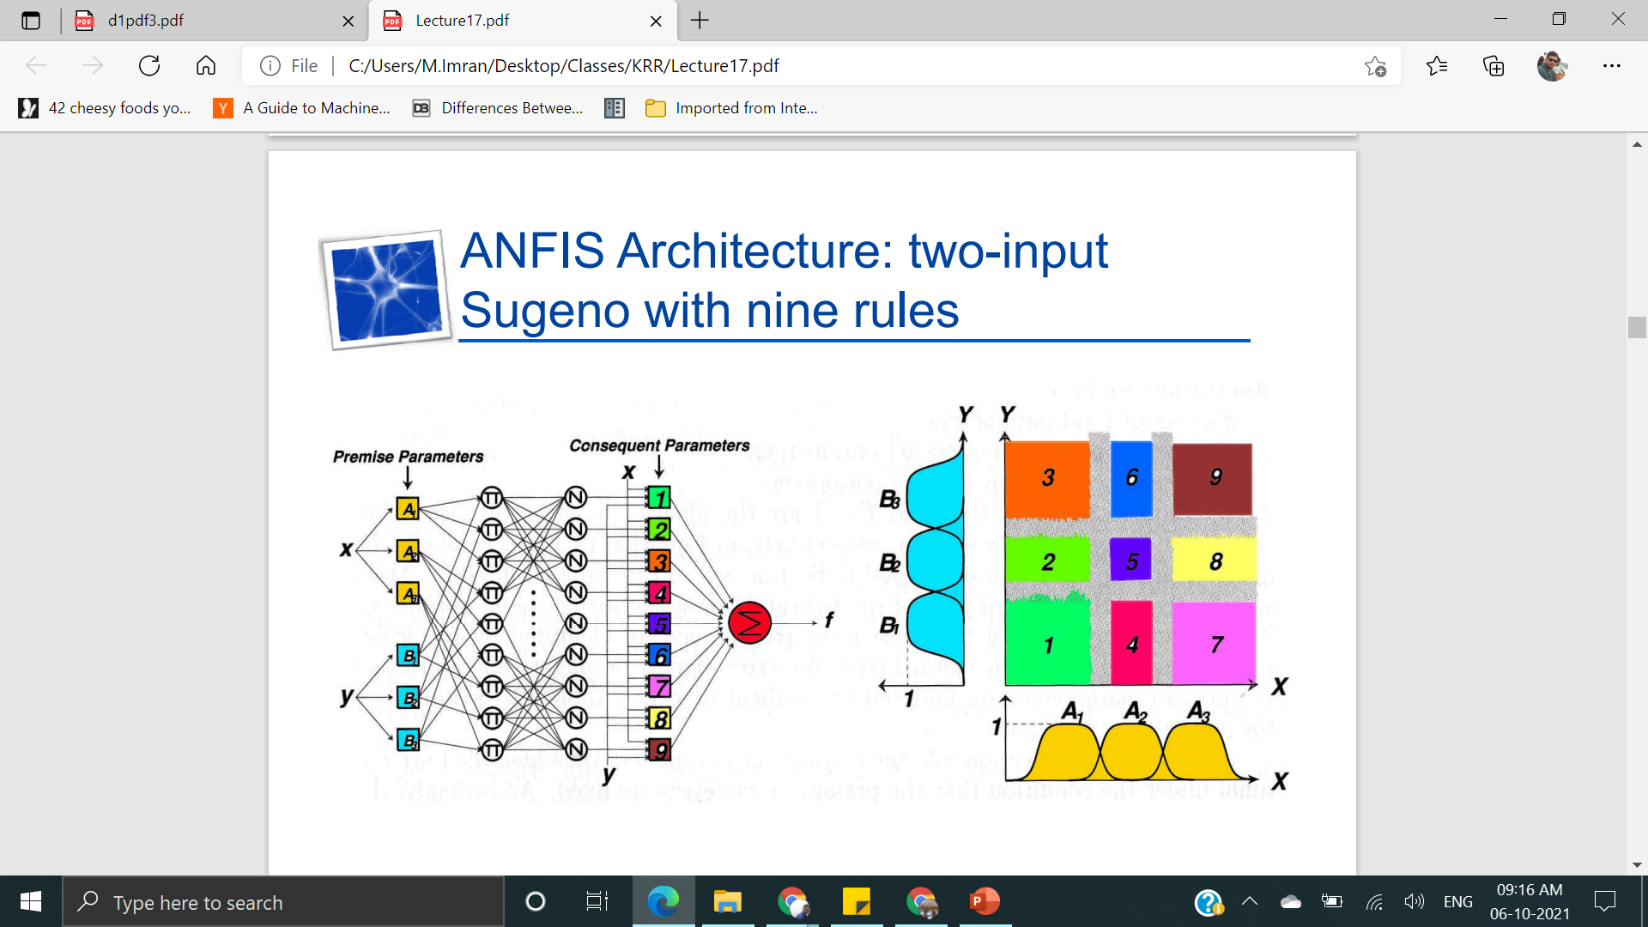
2 input with 9 rules

Slide 16
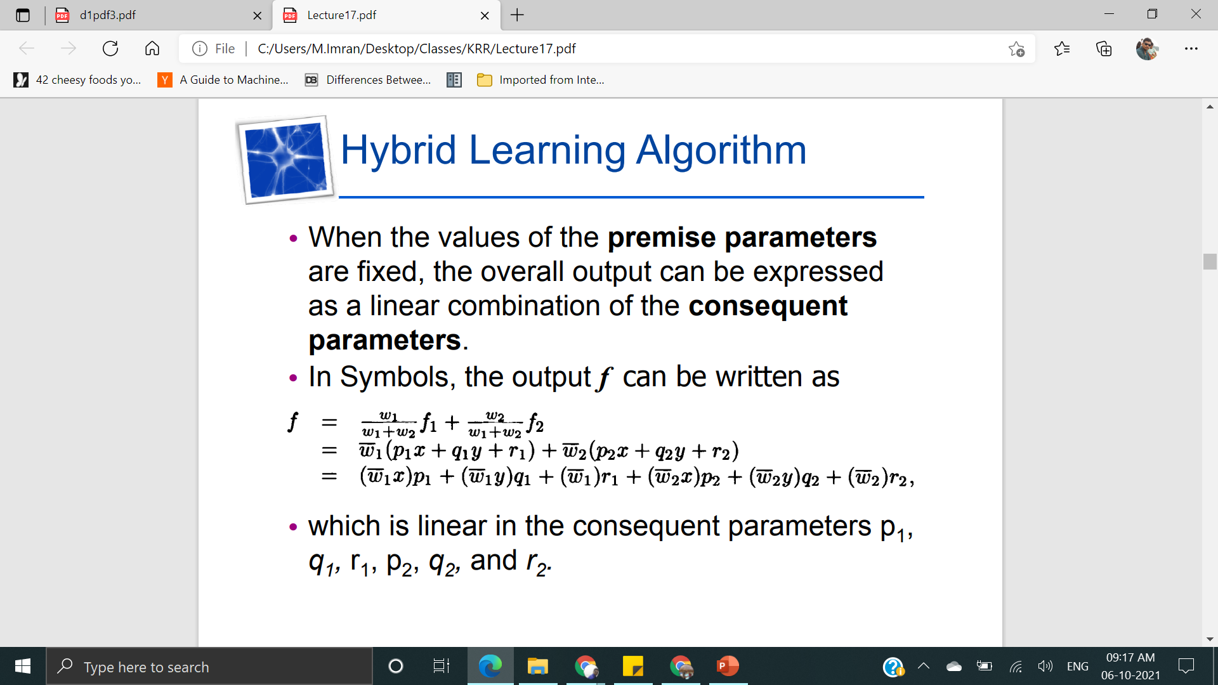
Hybrid Learning Algorithm

Slide 17
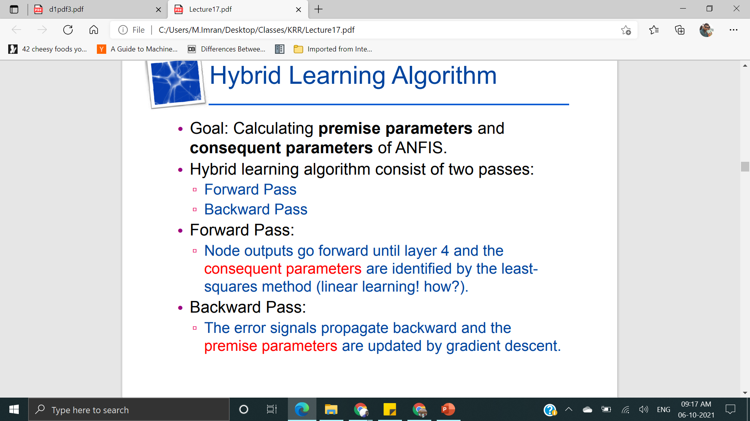

Slide 18
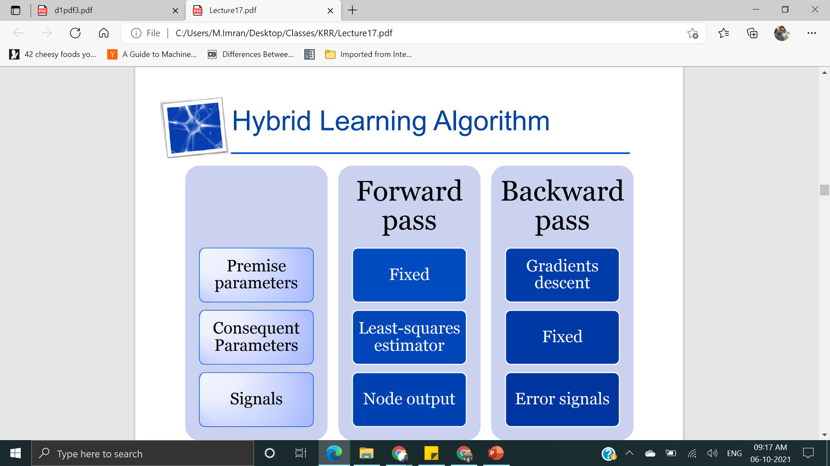

Slide 19
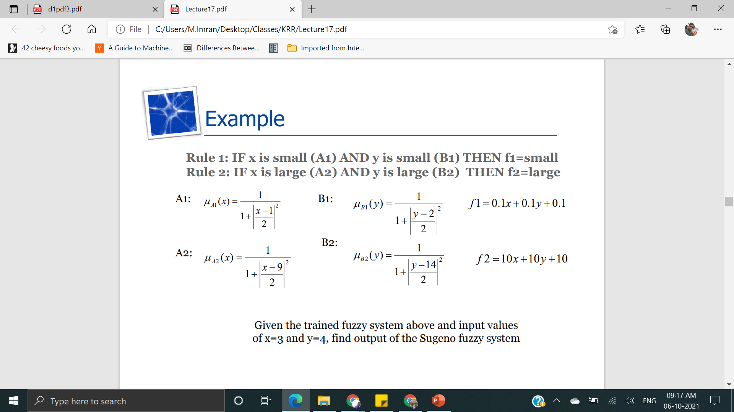
Example

Slide 20
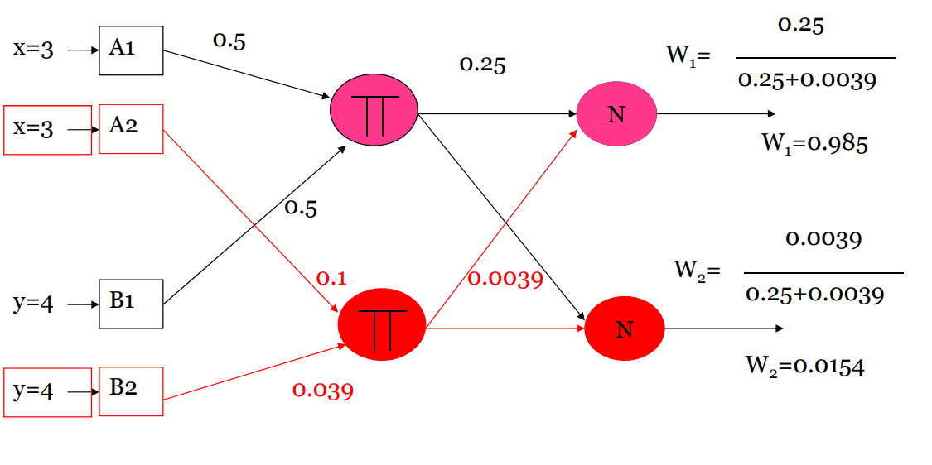

Slide 21
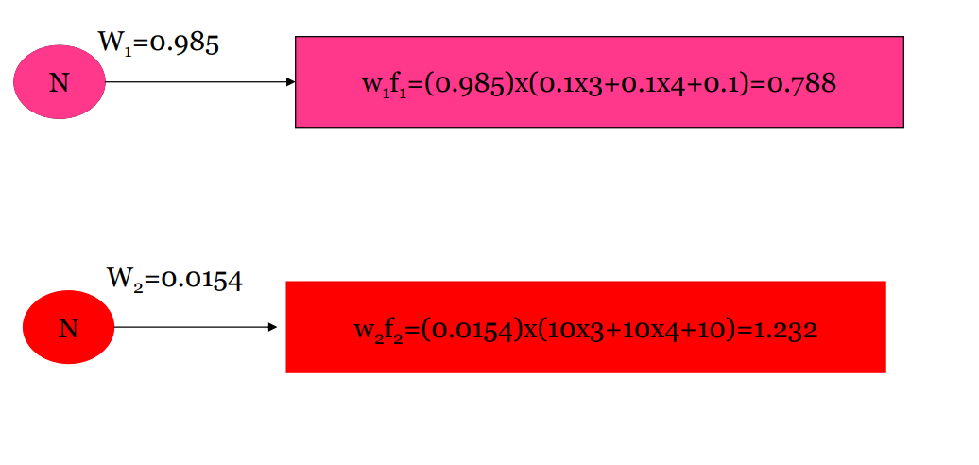

Slide 22
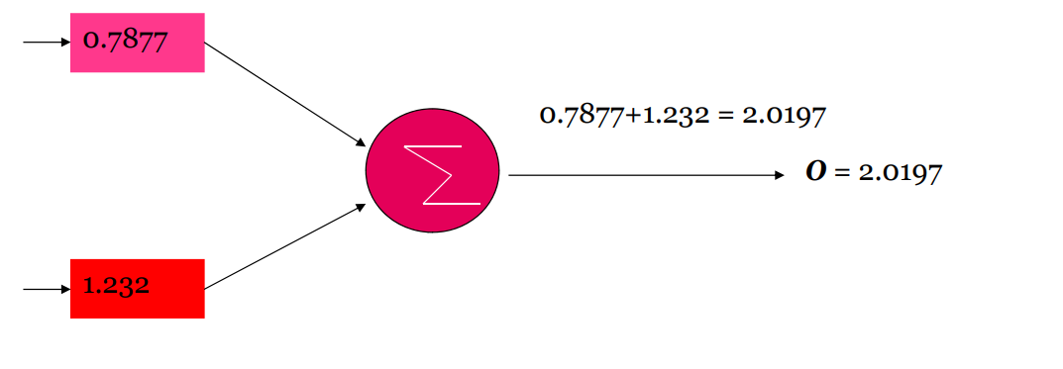

Slide 23
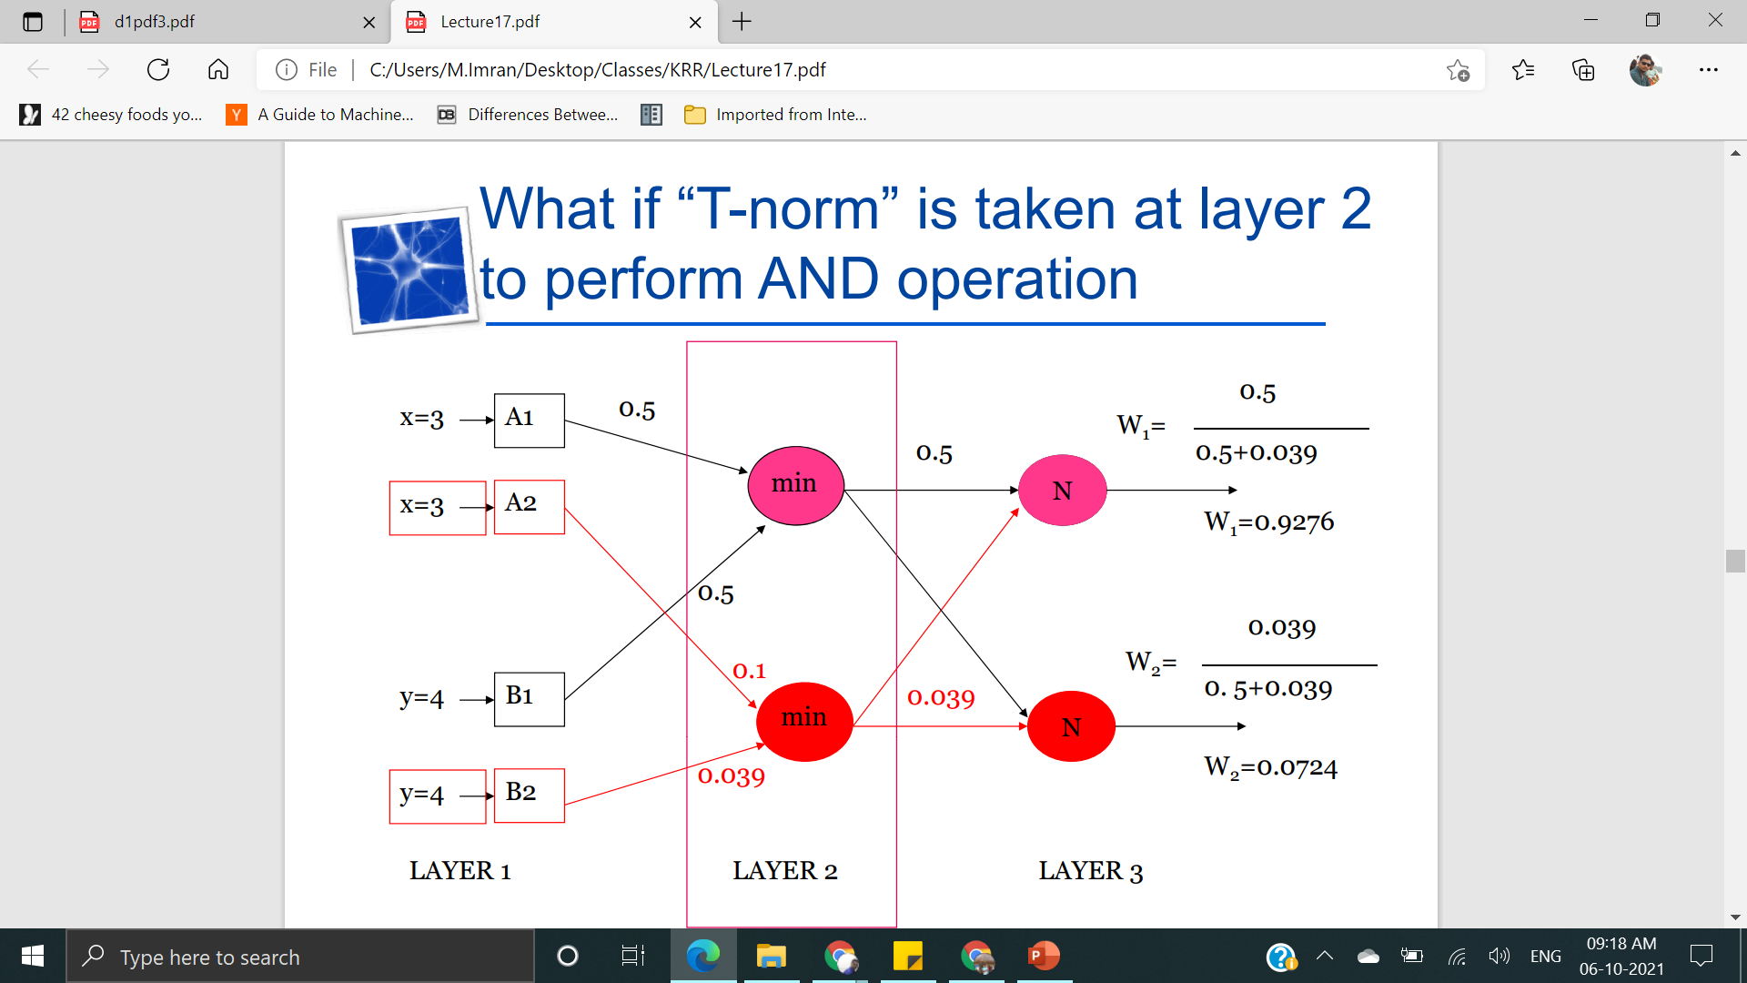
What id “T-norm”is taken at layer 2 to perform AND operation

Slide 24
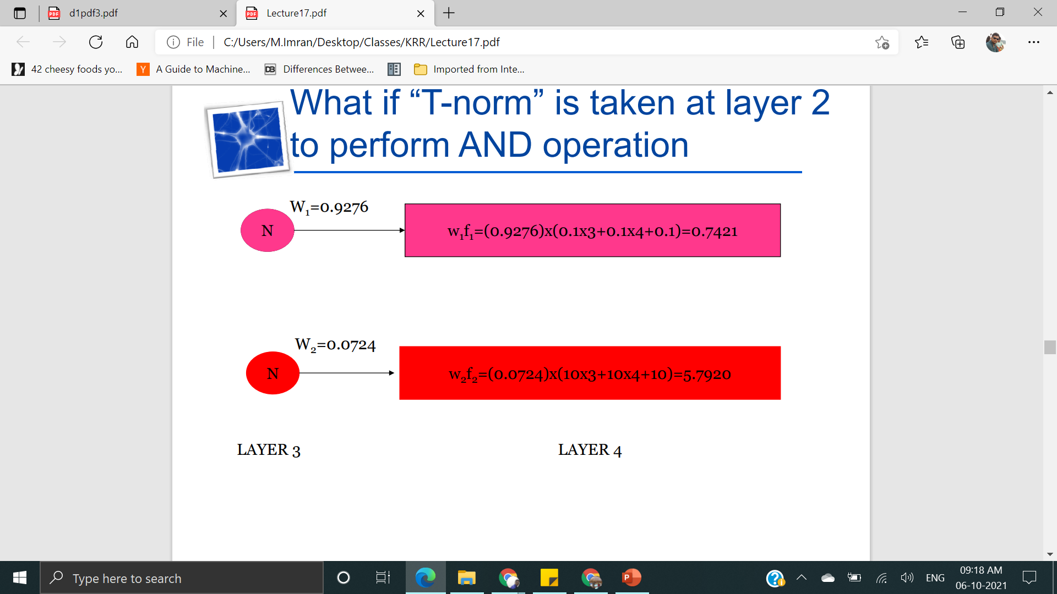

Slide 25
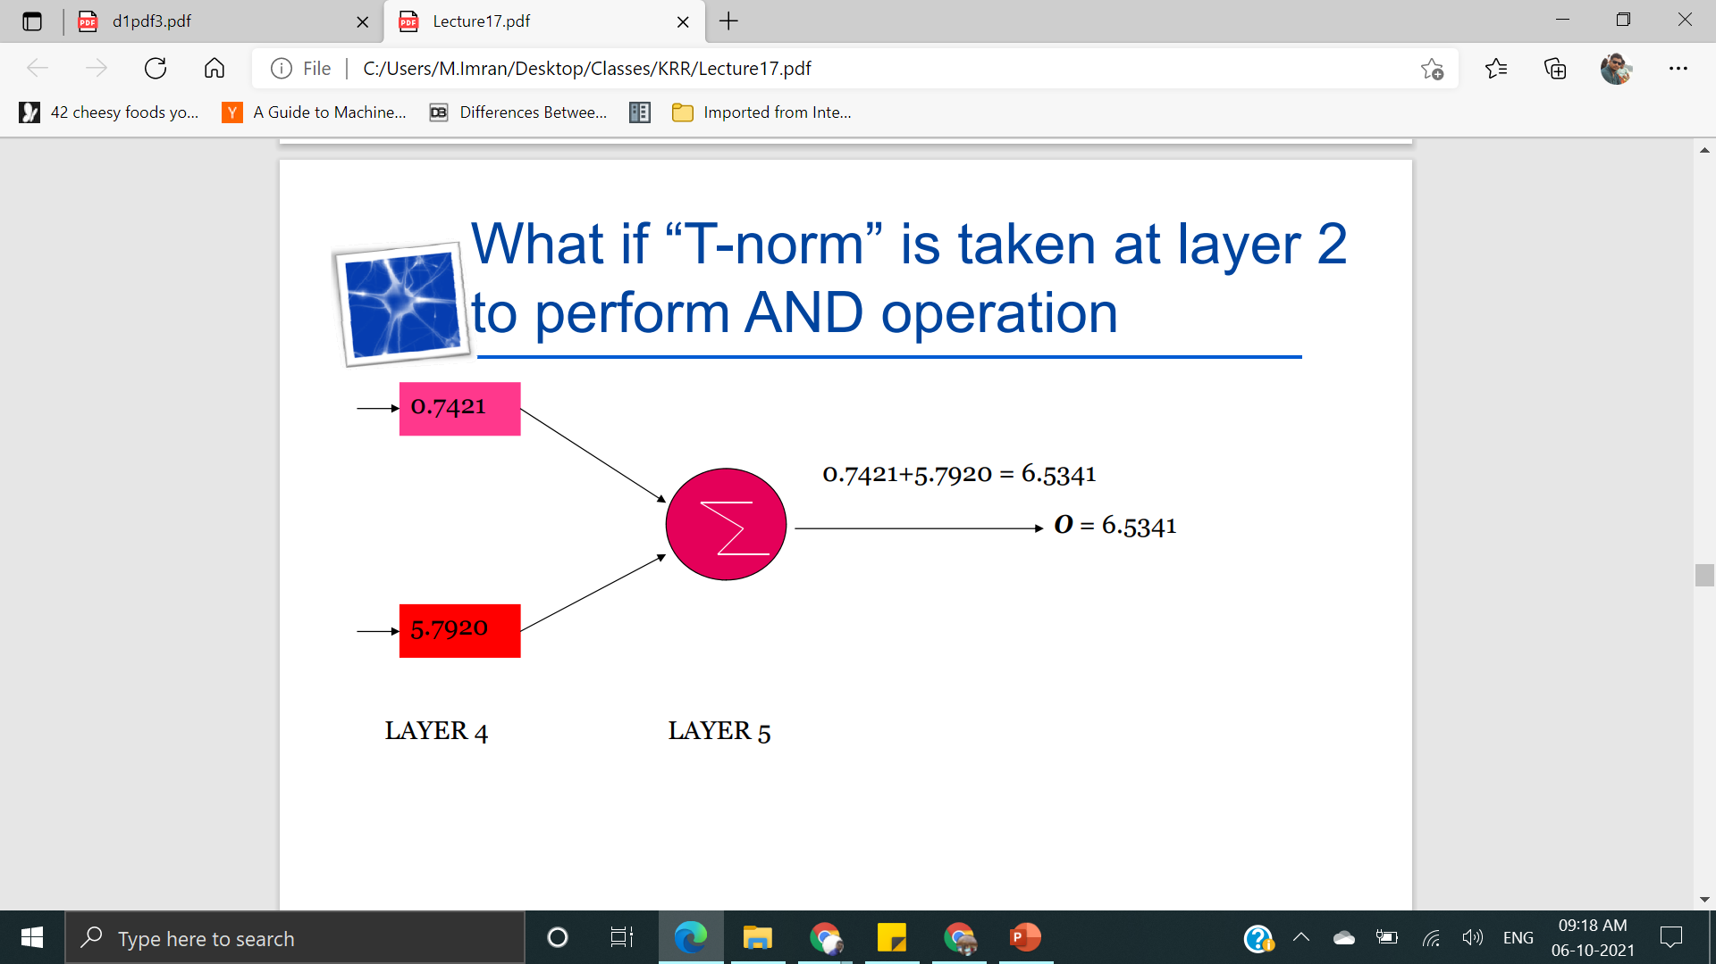

Slide 26
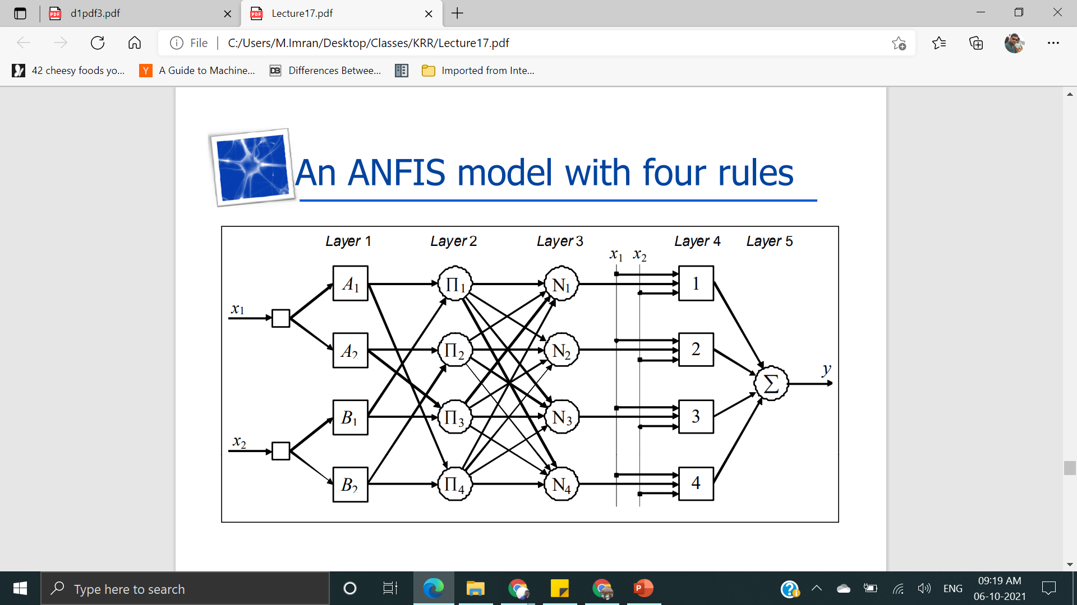
ANFIS with 4 rules

Slide 27
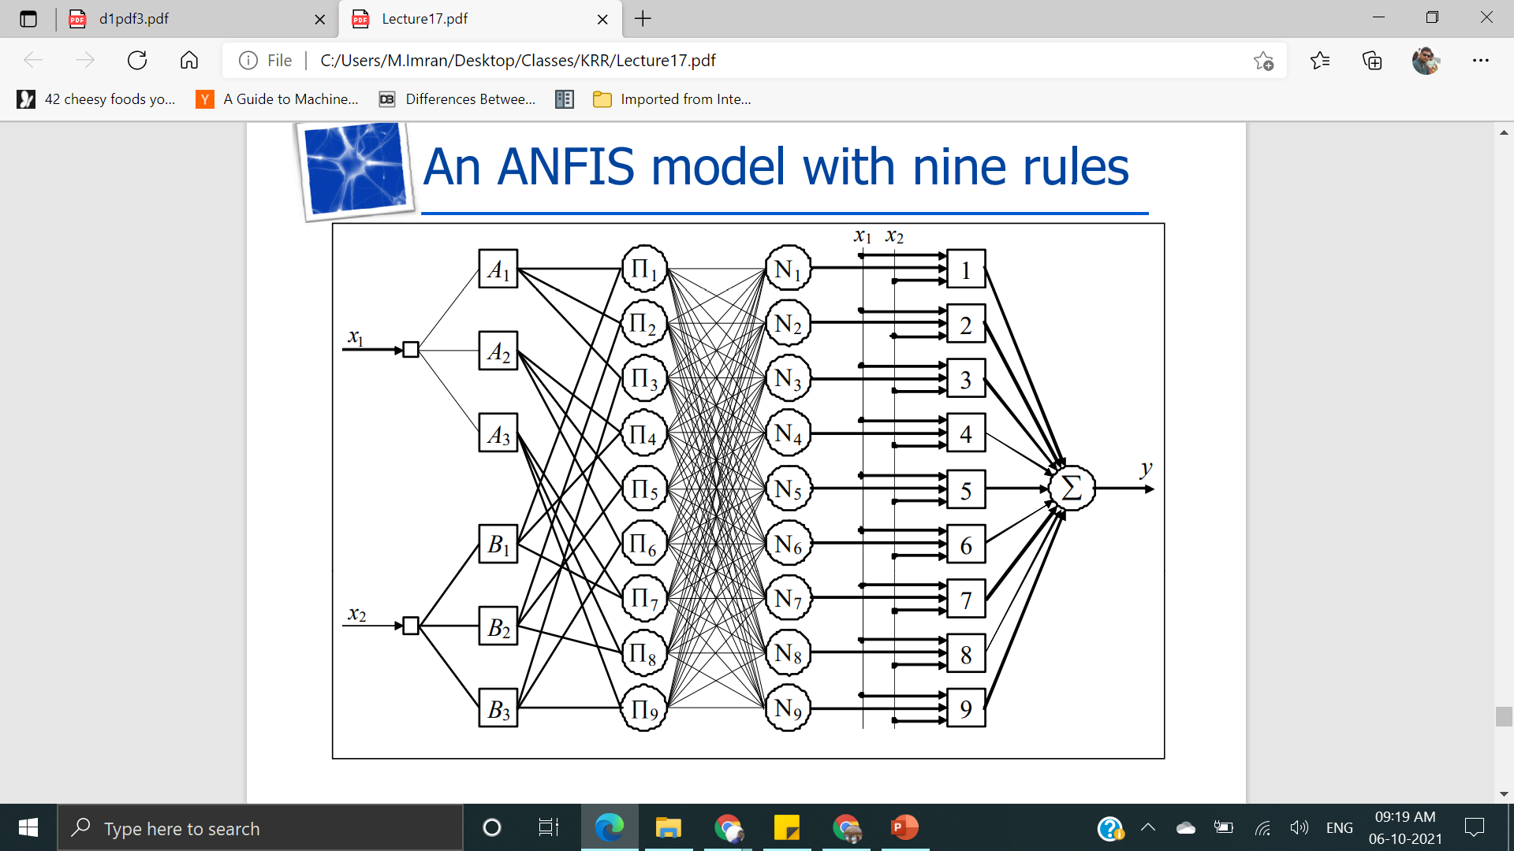
With 9 rules

